Slide 1
The Battle of Neighborhoods

Slide 2
Business problem
Glo-vate is a Global Business
Continuously considering new prospects internationally. Lately, the company desires to invest in a Restaurant Industry.
Interested in Manhattan, New York or Downtown, Toronto
Wants to compare the neighborhoods of the places and determine how parallel or different they are

Slide 3
Data description
Data will be fetched and explored of Manhattan, New York and Downtown, Toronto from Foursquare API.
Focused on restaurants, coffee shops and entertainment venues.
Neighborhood Segmentation and Clustering will be applied.
Which city is the better place for Glo-vate to invest in

Slide 4
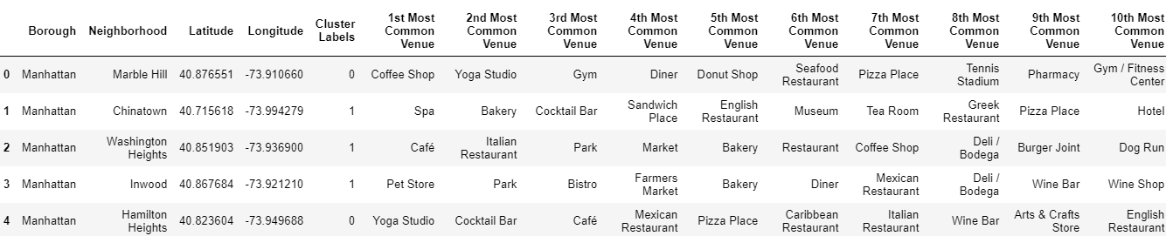
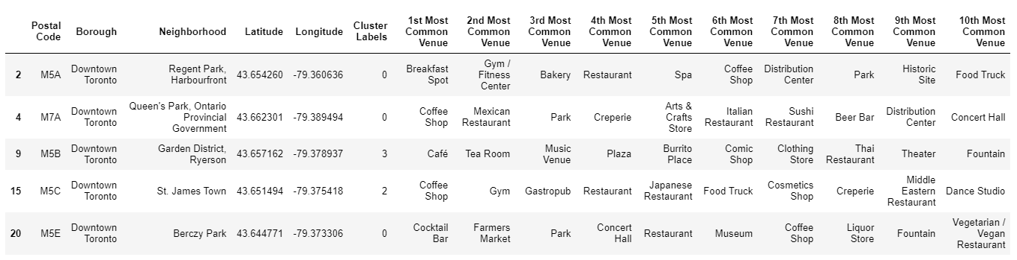
Most Common Venues in both Cities

Slide 5
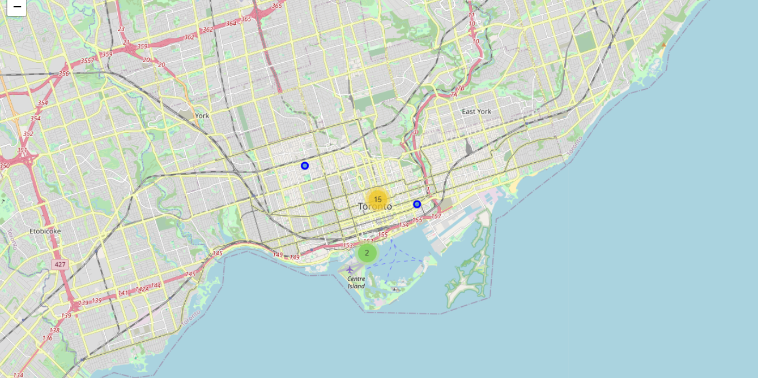
Map of Downtown, Toronto Clusters

Slide 6
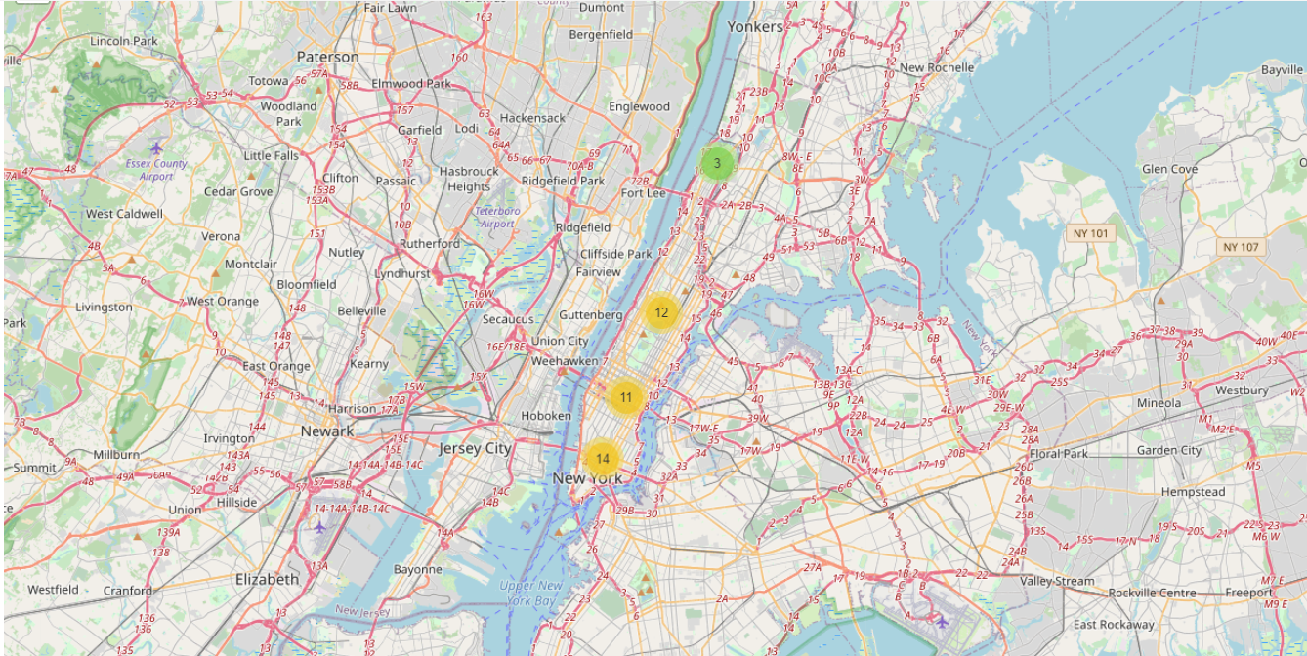
Map of Manhattan, New York Clusters

Slide 7
Methodology
Processed data that includes Downtown, Toronto & New York, Manhattan
Python folium library to visualize geographic details.
The Foursquare API is used to utilize and explore the neighborhoods and segment them.
The LIMIT parameter is set to 20,
One Hot Encoding, is used in order to group data
K-means algorithm is used to cluster the neighborhoods.
k_cluster value of 5 was used to divided the neighborhoods into 5 different clusters

Slide 8
Discussion
Find out which city should Glo-vate invest in
Manhattan, New York or Downtown, Toronto, Canada.
We analyze the clusters and see similar venues in both cities.

Slide 9
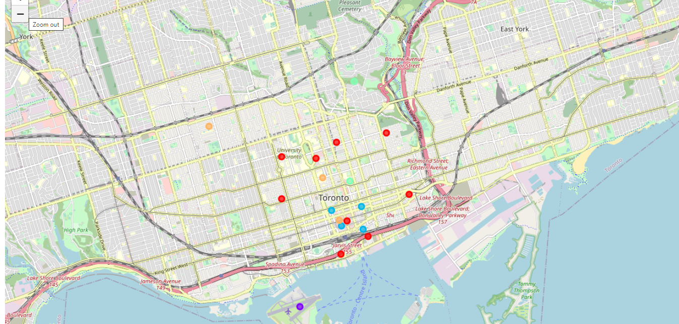
Top Restaurants in Downtown, Toronto

Slide 10
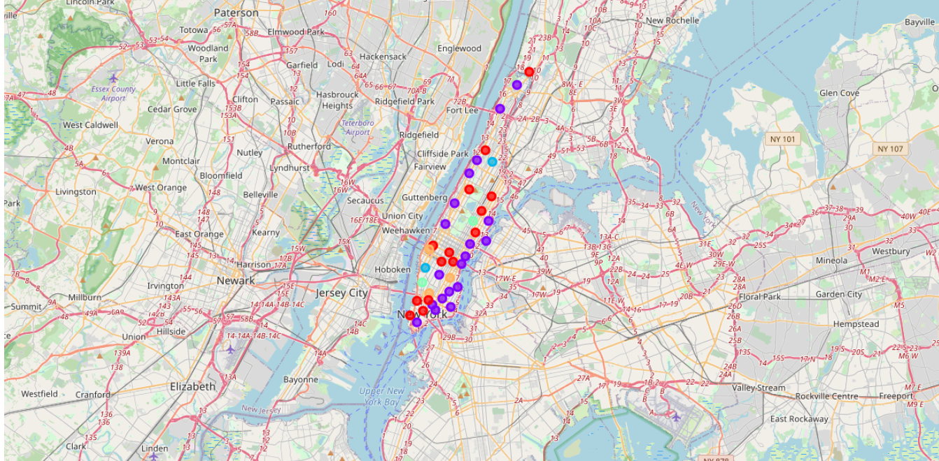
Top Restaurants in Manhattan, NY

Slide 11
Results & Conclusion
Manhattan, New York has more varied restaurants and entertainment venues than Downtown Toronto, Canada.
More than likely the area will attract more walk-ins and prospects.
The more diverse restaurants and cafes are in neighborhoods, the more individuals are exposed to different types of food, entertainment and cultures.
With the information presented, it would be recommended that Glo-vate invest in their Restaurant in Mahattan, New York.

